Slide 1
Quality of Service (QoS) and Congestion Control(Traffic Management)

Slide 2
Quality of Service and congestion control are the two interrelated topics
QoS and congestion is a major factor in total three layers namely :
Data link layer
Network Layer
Transport Layer

Slide 3
Traffic parameters:
Average data rate : The average data rate is nothing but the number of bits sent during a period of time, divided by the number of seconds in that period i.e. avg data rate = (Amount of data)/(time)
Peak data rate : The peak data rate defines the maximum data rate of the traffic. It indicates the peak bandwidth that the network requires for the traffic to pass through without changing its data flow.
Maximum burst size : The maximum burst size normally refers to the maximum length of time the traffic is generated at the peak rate.
Effective bandwidth : The effective bandwidth is the bandwidth that the network needs to allocate for the flow of traffic. The effective bandwidth is basically a function of three values i.e average data rate, peak data rate, and maximum burst size.

Slide 4
Congestion Control
Congestion in a network or internetwork may occur
if the load on the network—the number of packets sent to the network—is greater than the capacity of the network—the number of packets a network can handle.
because routers and switches have queues—buffers that hold the packets before and after processing.
Congestion control refers to
the mechanisms and techniques to control the congestion and keep the load below the capacity.
techniques and mechanisms that can either prevent congestion, before it happens, or remove congestion, after it has happened.

Slide 5
Congestion control techniques can be broadly classified into two categories:
Open Loop Congestion Control - prevents the congestion from happening
Closed Loop Congestion Control - removes congestion after it has taken place.

Slide 6
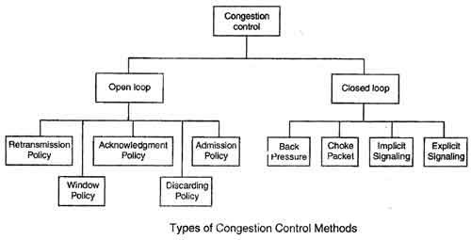

Slide 7
Open Loop Congestion Control
In this method, policies are used to prevent the congestion before it happens.
Congestion control is handled either by the source or by the destination.
The various methods used for open loop congestion control are:
Retransmission Policy
Window Policy
Acknowledgement Policy
Discarding Policy
Admission Policy

Slide 8
Retransmission Policy
The sender retransmits a packet, if it feels that the packet it has sent is lost or corrupted.
However retransmission in general may increase the congestion in the network. But we need to implement good retransmission policy to prevent congestion.
The retransmission policy and the retransmission timers need to be designed to optimize efficiency and at the same time prevent the congestion.

Slide 9
Window Policy
To implement window policy, selective reject window method is used for congestion control.
Selective Reject method is preferred over Go-back-n window as in Go-back-n method, when timer for a packet times out, several packets are resent, although some may have arrived safely at the receiver. Thus, this duplication may make congestion worse.
Selective reject method sends only the specific lost or damaged packets.

Slide 10
Acknowledgement Policy
The acknowledgement policy imposed by the receiver may also affect congestion.
If the receiver does not acknowledge every packet it receives it may slow down the sender and help prevent congestion.
Acknowledgments also add to the traffic load on the network. Thus, by sending fewer acknowledgements we can reduce load on the network.
To implement it, several approaches can be used:
1. A receiver may send an acknowledgement only if it has a packet to be sent.
2. A receiver may send an acknowledgement when a timer expires.
3. A receiver may also decide to acknowledge only N packets at a time.

Slide 11
Discarding Policy
A router may discard less sensitive packets when congestion is likely to happen.
Such a discarding policy may prevent congestion and at the same time may not harm the integrity of the transmission.

Slide 12
Admission Policy
An admission policy, which is a quality-of-service mechanism, can also prevent congestion in virtual circuit networks.
Switches in a flow first check the resource requirement of a flow before admitting it to the network.
A router can deny establishing a virtual circuit connection if there is congestion in the "network or if there is a possibility of future congestion.

Slide 13
Closed Loop Congestion Control
Closed loop congestion control mechanisms try to remove the congestion after it happens.
The various methods used for closed loop congestion control are:
Backpressure
Choke Packet
Implicit Signaling
Explicit Signaling

Slide 14
Backpressure
Backpressure is a node-to-node congestion control that starts with a node and propagates, in the opposite direction of data flow.
The backpressure technique can be applied only to virtual circuit networks. In such virtual circuit each node knows the upstream node from which a data flow is coming.
In this method of congestion control, the congested node stops receiving data from the immediate upstream node or nodes.
This may cause the upstream node on nodes to become congested, and they, in turn, reject data from their upstream node or nodes.

Slide 15
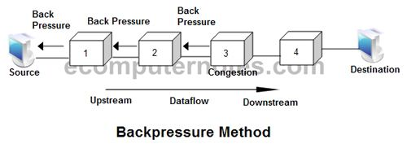
As shown in fig node 3 is congested and it stops receiving packets and informs its upstream node 2 to slow down. Node 2 in turns may be congested and informs node 1 to slow down. Now node 1 may create congestion and informs the source node to slow down. In this way the congestion is alleviated. Thus, the pressure on node 3 is moved backward to the source to remove the congestion.

Slide 16
Choke Packet
In this method of congestion control, congested router or node sends a special type of packet called choke packet to the source to inform it about the congestion.
Here, congested node does not inform its upstream node about the congestion as in backpressure method.
In choke packet method, congested node sends a warning directly to the source station i.e. the intermediate nodes through which the packet has traveled are not warned.

Slide 17
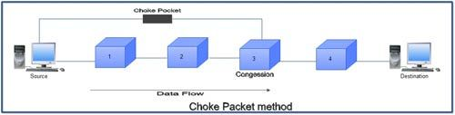

Slide 18
Implicit Signaling
In implicit signaling, there is no communication between the congested node or nodes and the source.
The source guesses that there is congestion somewhere in the network when it does not receive any acknowledgment. Therefore the delay in receiving an acknowledgment is interpreted as congestion in the network.
On sensing this congestion, the source slows down.
This type of congestion control policy is used by TCP.

Slide 19
Explicit Signaling
In this method, the congested nodes explicitly send a signal to the source or destination to inform about the congestion.
Explicit signaling is different from the choke packet method. In choke packed method, a separate packet is used for this purpose whereas in explicit signaling method, the signal is included in the packets that carry data .
Explicit signaling can occur in either the forward direction or the backward direction .
In backward signaling, a bit is set in a packet moving in the direction opposite to the congestion. This bit warns the source about the congestion and informs the source to slow down.
In forward signaling, a bit is set in a packet moving in the direction of congestion. This bit warns the destination about the congestion. The receiver in this case uses policies such as slowing down the acknowledgements to remove the congestion.

Slide 20
Congestion Control in TCP
TCP uses a congestion window and a congestion policy that avoid congestion and detect and alleviate congestion after it has occurred.
Congestion Window
The receiver that can dictate to the sender the size of the sender’s window.
In addition to the receiver, the network is a second entity that determines the size of the sender’s window.
The sender has two pieces of information: the receiver-advertised window size and the congestion window size.
The actual size of the window is the minimum of these two.
Actual window size = minimum (rwnd, cwnd)

Slide 21
Congestion Policy
TCP’s general policy for handling congestion is based on three phases:
slow start,
Congestion avoidance,
congestion detection.
In the slow start phase, the sender starts with a slow rate of transmission, but increases the rate rapidly to reach a threshold.
When the threshold is reached, the rate of increase is reduced.
Finally if ever congestion is detected, the sender goes back to the slow start or congestion avoidance phase, based on how the congestion is detected.

Slide 22
Slow Start: Exponential Increase
The slow start algorithm is based on the idea that the size of the congestion window (cwnd) starts with one maximum segment size (MSS).
The MSS is determined during connection establishment using an option of the same name.
The size of the window increases one MSS each time one acknowledgement arrives.
As the name implies, the algorithm starts slowly, but grows exponentially

Slide 23
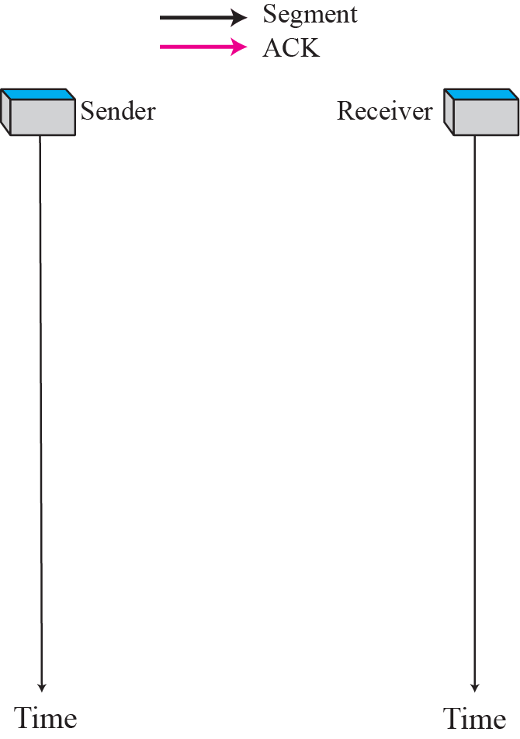
Slow start, exponential increase

Slide 24
Congestion Avoidance: Additive Increase
To avoid congestion before it happens, one must slow down this exponential growth.
TCP defines another algorithm called congestion avoidance, which increases the cwnd additively instead of exponentially.
In this algorithm, each time the whole “window” of segments is acknowledged, the size of the congestion window is increased by one.
A window is the number of segments transmitted during RTT. In other words, the increase is based on RTT, not on the number of arrived ACKs.

Slide 25
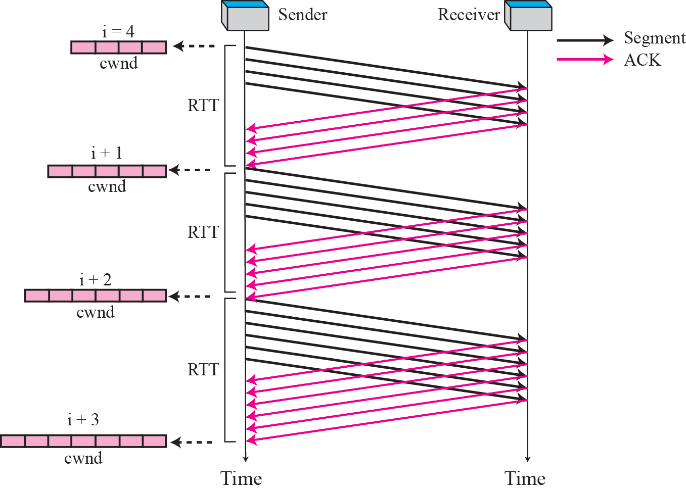
Congestion avoidance, additive increase

Slide 26
Congestion Detection: Multiplicative Decrease
If congestion occurs, the congestion window size must be decreased.
Retransmission is needed to recover a missing packet which may be dropped by the network
Retransmission can occur in one of two cases:
when the RTO timer times out
when three duplicate ACKs are received.
In both cases, the size of the threshold is dropped to half (multiplicative decrease).

Slide 27
Most TCP implementations have two reactions:
If a time-out occurs, there is a stronger possibility of congestion; a segment has probably been dropped in the network and there is no news about the following sent segments.
In this case TCP reacts strongly:
a. It sets the value of the threshold to half of the current window size.
b. It reduces cwnd back to one segment.
c. It starts the slow start phase again.

Slide 28
2. If three duplicate ACKs are received, there is a weaker possibility of congestion; a segment may have been dropped but some segments after that have arrived safely since three duplicate ACKs are received. This is called fast transmission and fast recovery.
In this case, TCP has a weaker reaction as shown below:
a. It sets the value of the threshold to half of the current window size.
b. It sets cwnd to the value of the threshold (some implementations add three segment sizes to the threshold).
c. It starts the congestion avoidance phase.

Slide 29
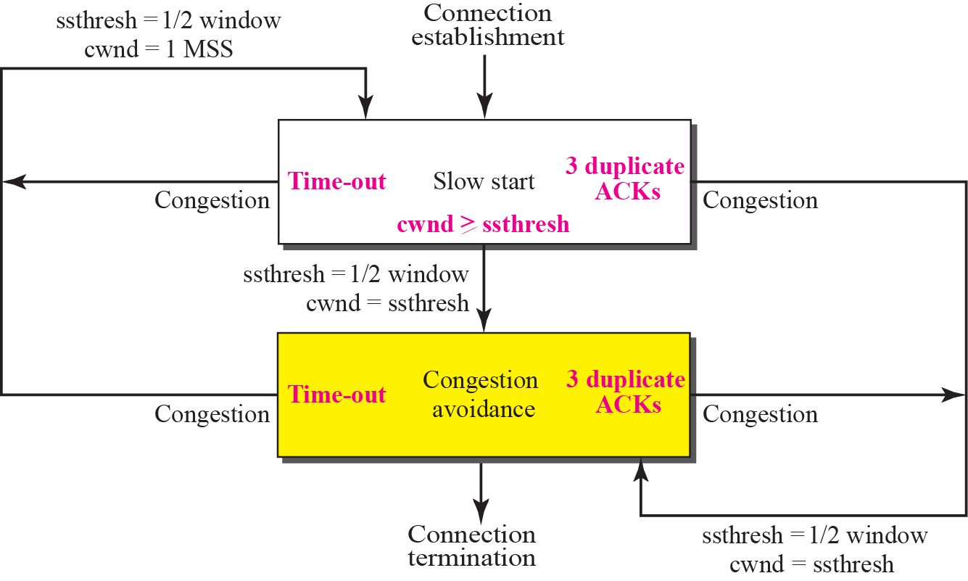
TCP Congestion policy summary

Slide 30
QoS (Quality of Service)
QoS is nothing but a quality that every flow seeks to attain i.e., smooth movement without any congestion.
Factors to consider:
Connection Establishment Delay
Source-to-destination delay is a flow characteristic.
Applications can tolerate delay in different degrees. In this case, telephony, audio conferencing, video conferencing, and remote login basically need a minimum delay, while delay in file transfer or e-mail is less important.
The time difference mainly between the instant at which a transport connection is requested and the instant at which it is confirmed is called connection establishment delay.
The shorter the delay the better the quality of service (QoS).

Slide 31
Connection Establishment Failure Probability
It is the probability that a connection is not established even after the maximum connection establishment delay. This can be due to network congestion, lack of table space, or some other problems.
Throughput
It mainly measures the number of bytes of user data transferred per second, measured over some time interval. It is measured separately for each direction.
Different applications need different bandwidths. In video conferencing, we need to send millions of bits per second to refresh a color screen while the total number of bits in an e-mail may not reach even a million.

Slide 32
Transit Delay
It is the time between a message being sent by the transport user on the source machine and its being received by the transport user in the destination machine.
Priority
This parameter provides a way for the user to show that some of its connections are more important (have higher priority) than the other ones.
This is important while handling congestion because the higher priority connections should get service before the low priority connections.
Resilience
Due to internal problems or congestion, the transport layer spontaneously terminates a connection. The resilience parameter gives the probability of such a termination .

Slide 33
Residual Error Ratio
It measures the number of lost or distorted messages as a fraction of the total messages sent. Ideally, the value of this ratio should be zero and practically it should be as small as possible.
Reliability
Lack of reliability means losing a packet or acknowledgment(being sent on its successful reach to destination), which entails retransmission.
However, the sensitivity of any application programs to reliability is not the same. for e.g file transfer and email service require reliable service unlike telephone or audio conferencing.
Jitter
Jitter is the variation in delay for packets associated with the same flow. For applications such as audio and video applications, it does not matter if the packets arrive with a short or long delay as long as the delay is the same for all packets.
High jitter means the difference between delays(of packets of data) is large, low jitter means the variation is small.

Slide 34
To regulate the bursty traffic(large traffic arriving at a very small interval) into regulated traffic(and thereby reducing the congestion)
Common methods used for nullifying the congestion are :
FIFO queuing
Priority queuing
Weighted fair queuing
Traffic shaping
Resource Reservation
Admission Control

Slide 35
FIFO queuing
In first-in, first-out (FIFO) queuing method, packets wait in a buffer ( or queue) until the node (switching device e.g. router or switch) is ready to process them.
If the average arrival rate is higher than the average processing rate, the queue will fill up and new packets will be discarded.
Only one buffer is required

Slide 36
Priority Queuing QoS
In this queuing method, packets are first assigned to a priority level. Each priority level has its own queue. The packets are in the highest-priority queue are processed first.
Packets in the lowest-priority queue are processed last. The system doesn’t stop serving a queue until it is empty. A priority queue can generally provide better QoS than the FIFO queue because higher the priority traffic such as multimedia, can reach the destination with less delay.
However, there is a potential drawback. If there is a continuous flow from high-priority queue, the packets in the lower-priority queues will never get a chance to be processed. Threshold is used and then according to the priority, packets are accepted.

Slide 37
Weighted Fair Queuing in QoS
A better scheduling method is weighted fair queuing. In this technique, the packets are still assigned to the different classes and admitted to different queues. For providing better QoS, for high priority packets high weightage is given. The queues, are weighted based on the priority of the queues, higher the priority means a higher weight.
The system mainly processes packets in each queue in a round-robin fashion with the number of packets selected from each queue based on the corresponding weight. If any system doesn’t impose priority on the classes, all weights can be equal . In this way, we can have fair queuing with priority.

Slide 38
Traffic Shaping in QoS
Traffic shaping is a mechanism to control the amount and the rate (flow) of the traffic sent to the network. Two techniques deployed for this are : leaky bucket and token bucket algorithms (traffic management algorithms).
Leaky Bucket (Leaky Bucket Algorithm)
This is implemented using a buffer at the interface level. If a bucket has a small hole at the bottom, the water leaks from the bucket at a constant rate as long as there is water in the bucket.
The rate at which the water leaks does not depend on the rate at which the water is input to the bucket unless the bucket is empty. Buffer stores the data and forwards it in regular ‘T’ intervals (T is based upon network capacity).
The input rate can vary to an extent , but the output rate remains constant. Similarly, in networking, a technique called leaky bucket can smooth out bulk traffic. bulky chunks (of traffic) are stored in the bucket and sent out at an average rate.

Slide 39
Token Bucket (Token Bucket Algorithm)
The leaky bucket is a very restrictive and rigid algorithm . For example, if a host is not sending for a while, its bucket becomes empty. Now if the host has bursty data (large data coming at a time in the small interval), the leaky bucket allows only an average rate. We can say that the time when the host was idle is not taken into account.
On the other hand, the token bucket algorithm generally allows the idle hosts to accumulate credit for the future in the form of tokens. For instance, the system sends ‘n’ tokens to the bucket. The system removes one token for every cell (or byte) of data being sent. Thus in this packet discarding probability and data delay is less.

Slide 40
Resource Reservation in QoS
A flow of data basically needs resources such as a buffer, bandwidth, CPU time, and so on to maintain a steady flow. The quality of service (QoS) is improved if these resources can be reserved beforehand.
Admission Control in QoS
It is the mechanism used by a router, or a switch(or any networking device), to accept or reject a flow based on predefined parameters called flow specifications.
Before a router accepts any flow for processing, it checks the flow specifications to check if its capacity (in terms of bandwidth, buffer size, CPU speed, etc.) and its previous commitments to other flows can handle the new flow (thus implements an admission control for the flow of traffic).

